Slide 1
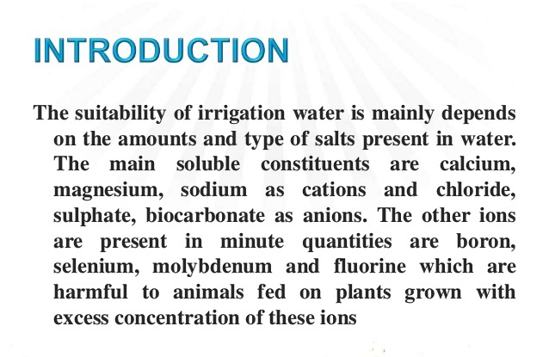

Slide 2
Irrigation water quality
Both irrigation water quality and proper irrigation management are critical to successful crop production. The quality of the irrigation water may affect both crop yields and soil physical conditions, even if other conditions and cultural practices are favorable/optimal.

Slide 7
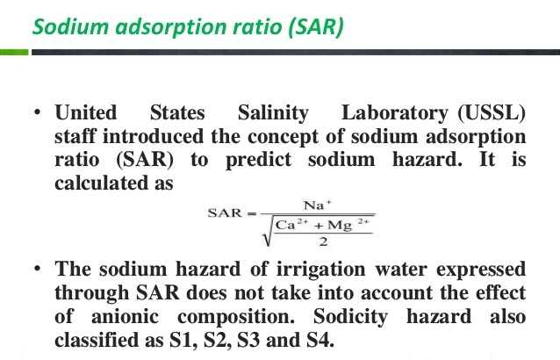

Slide 8
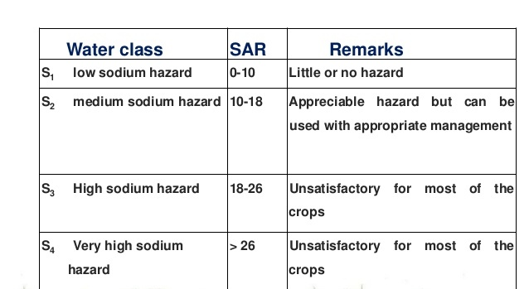

Slide 12
